Slide 1
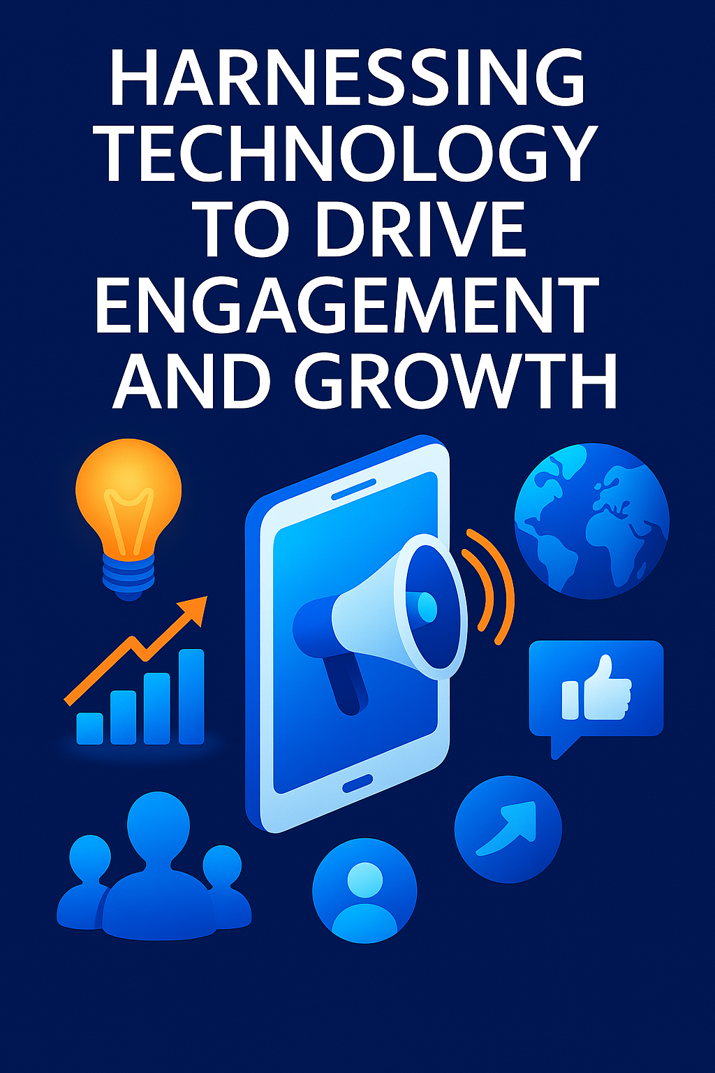

Innovative Marketing Techniques in the Digital Age
Harnessing Technology to Drive Engagement and Growth
Presented by: Richard Wadsworth
Date: 26/05/2025

Slide 2

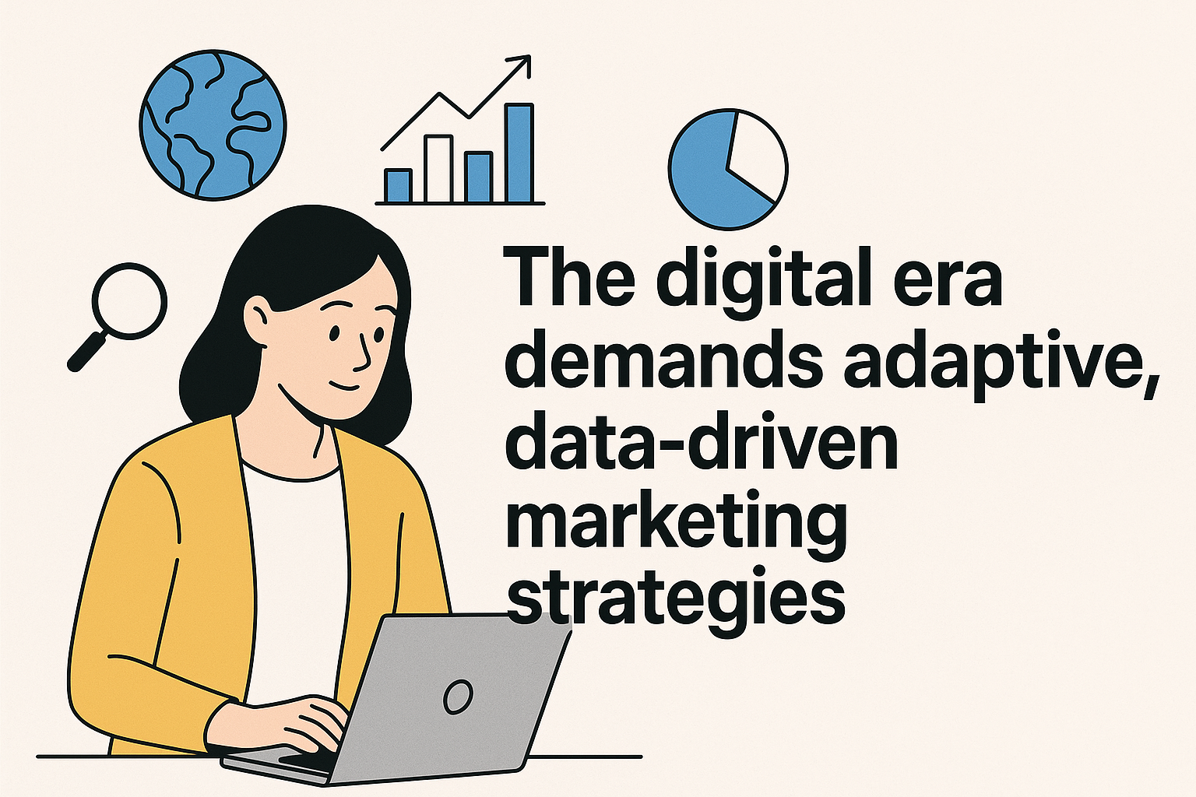

Slide 3
Introduction
The digital era demands adaptive, data-driven marketing strategies
Innovation and personalization are central to modern marketing success
Overview of emerging techniques shaping today’s landscape

Slide 4
AI-Powered Personalization
• Machine learning tailors content based on user behavior
• Tools: Adobe Sensei, HubSpot AI
• Benefits: Improved relevance, conversion, and loyalty

Slide 5

Influencer Microtargeting
• Leverages niche influencers for authentic engagement
• Platforms: TikTok, Instagram, LinkedIn
• Result: High trust, better ROI in focused segments

Slide 6
Conversational Marketing
• Real-time communication with users via chatbots and messaging
• Technologies: Drift, Intercom, ChatGPT integrations
• Use: Lead gen, support, and funnel acceleration

Slide 7
Content Atomization
• Breaks down long-form content into diverse micro-content
• Tools: Canva, Buffer
• Maximizes reach across platforms with minimal extra effort

Slide 8
Voice & Visual Search Optimization
• Prepares content for searches via voice assistants and images
• Tools: Google Lens, structured data tools
• Essential for mobile-first industries (retail, food, travel)

Slide 9
Interactive & Immersive Experiences
• AR/VR, 360° video, gamification
• Tools: Spark AR, Unity
• Drives deeper engagement and recall

Slide 10

USE:
Transparent Ad Tracking
Loyalty Systems
BENEFITS:
Data Integrity
Fraud Prevention

Slide 11
Predictive & Prescriptive Analytics
• Applications: Audience targeting, behavior forecasting
• Tools: Salesforce Einstein, Google Analytics 4
• Enables proactive, data-backed marketing decisions

Slide 12
Strategic Considerations
• Align tech with user needs and behavior insights
• Ensure compliance with data protection laws
• Train teams, A/B test, iterate continuously

Slide 13
Conclusion
• Innovation is key to competitive marketing
• Digital tools empower personalization, efficiency, and ROI
• Call to action: Evaluate current strategies and integrate key innovations

Slide 14

Q&A
Thank you
Questions and Discussion

